Slide 1








Energy Consumptions Prediction For Smart Homes
-Aabshaar Shaikh

Slide 2

Table of Content
Introduction
Importance of Energy Efficiency in Smart Homes/Buildings
Business Insights
Challenges Faced
Data Screenshot
Data Cleaning
Results Screenshot
Future Scope

Slide 3
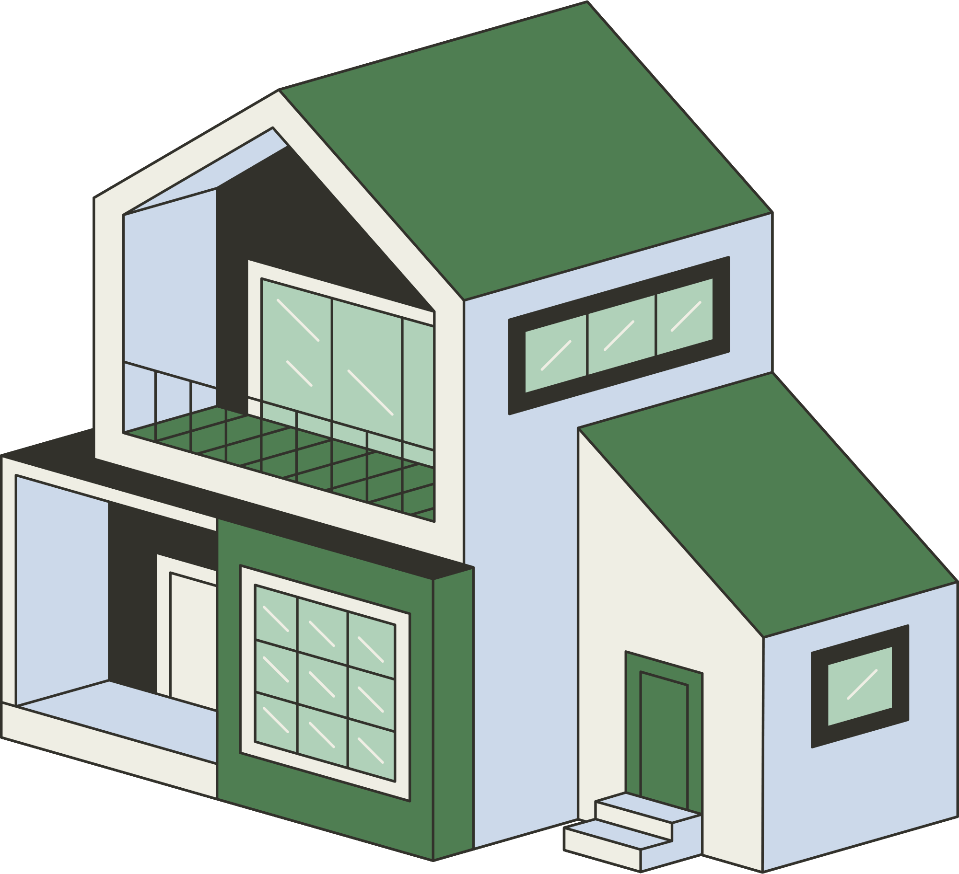
Introduction
In this technological era everything is made to act smart. So is a home.
A smart home is a place where all devices are designed to operate intelligently and can be programmed to maximize their benefits.
Despite these advancements, many buildings still experience inefficient energy use, leading to high costs and environmental impact.
This project aims to predict energy usage and provide insights to optimize energy consumption and to help homeowners & building managers, to make informed decisions, reduce energy costs, and to promote sustainability.

Slide 4

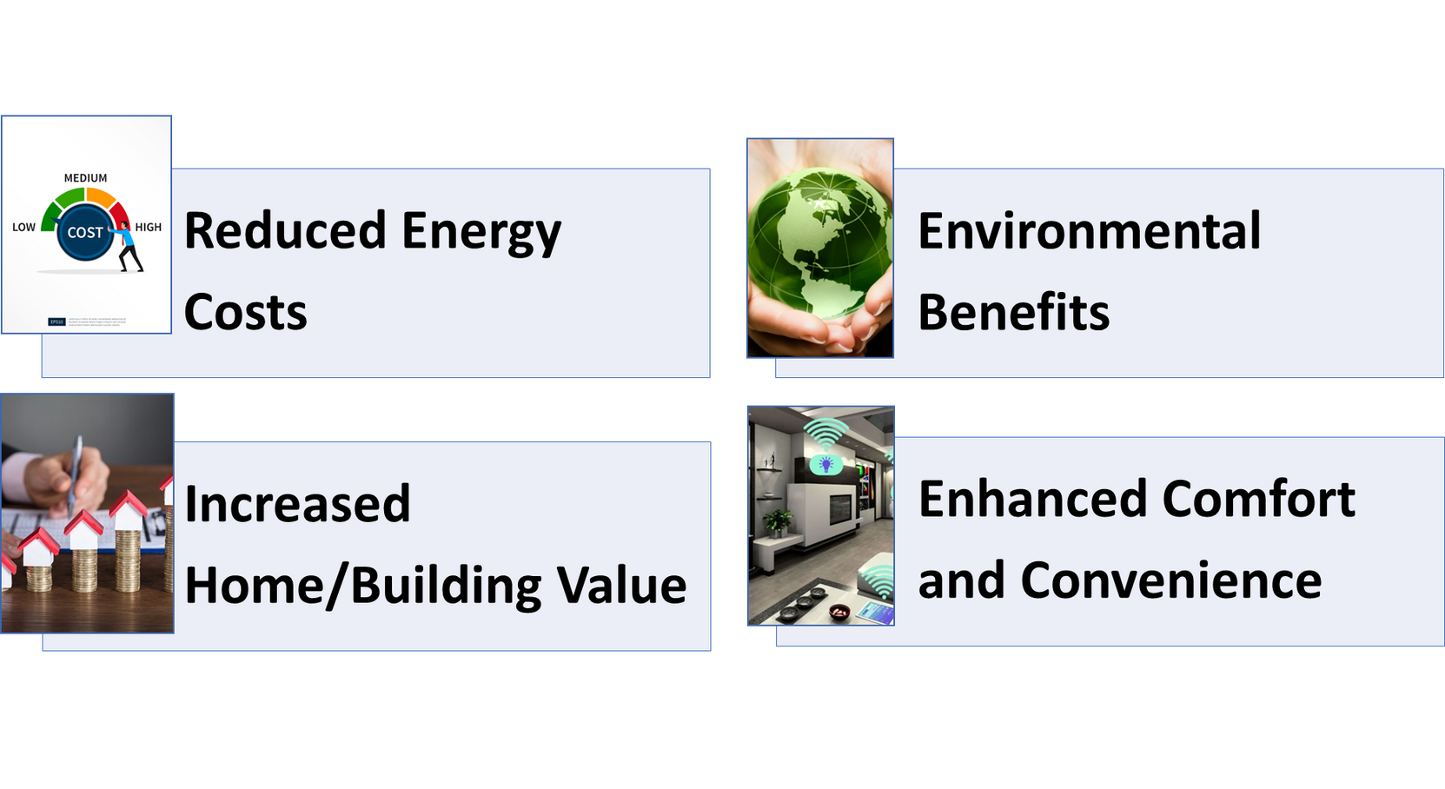
Importance of Energy Efficiency in Smart Homes/Buildings

Slide 5
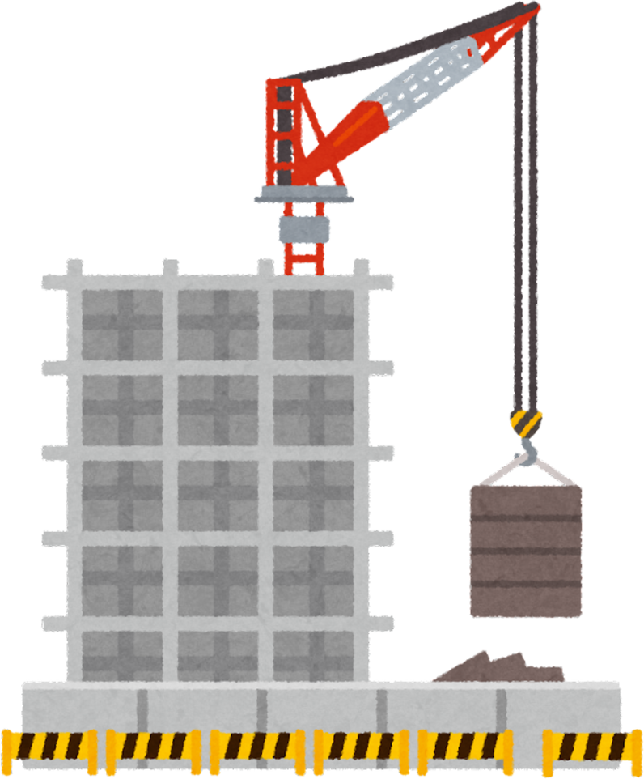
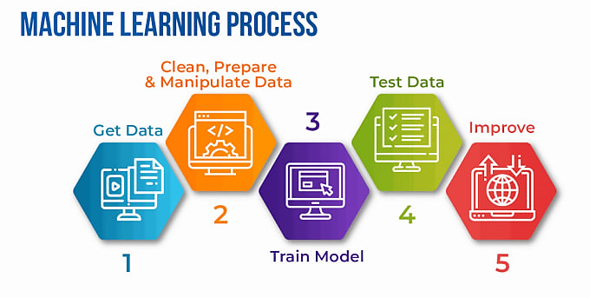
Methodology

Slide 6
BUSINESS INSIGHTS
Energy Efficiency Optimization
Resource Allocation & Cost Reduction
User Behaviour Analysis
Sustainability Goals
Customer Satisfaction

Slide 7


Challenges Faced
Dataset was too big and laptop was not able to load it. So needed to take a little less data
Tuning of Hyper Parameter took a lot of time.
Deployment was a challenging part

Slide 8

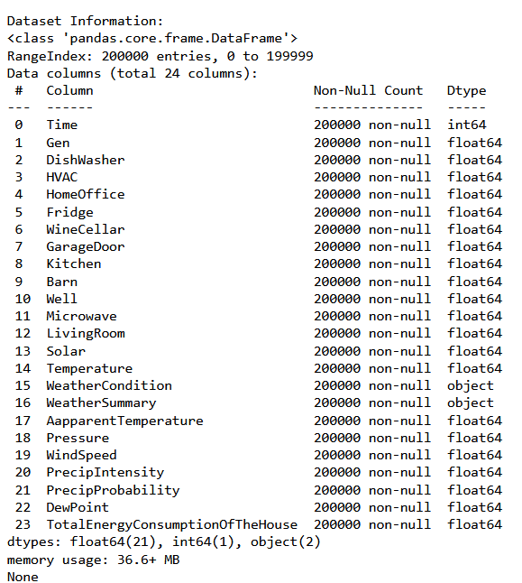
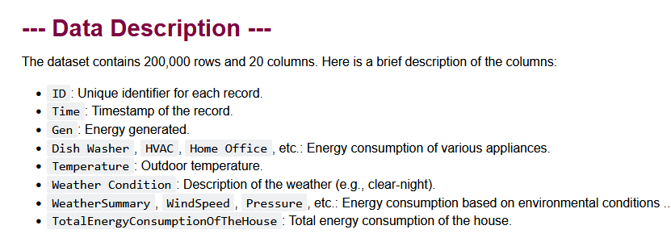
Gallery
Data Screenshots

Slide 9
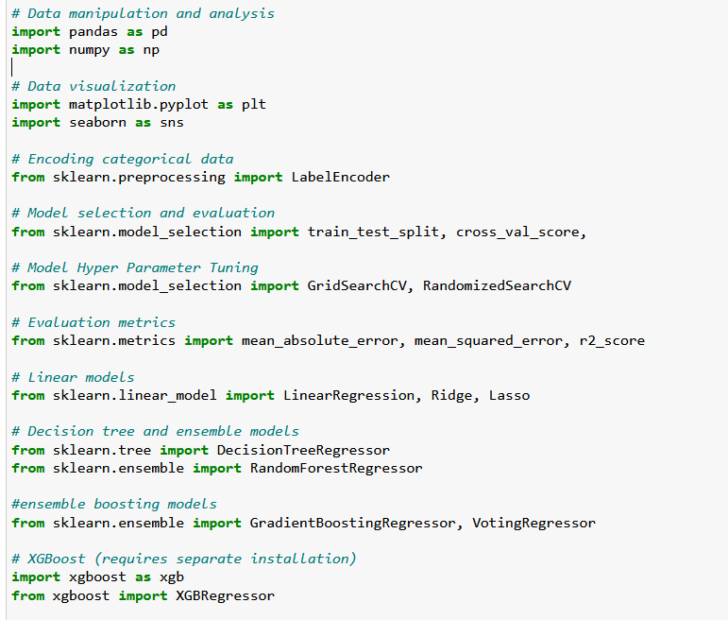
Library Used

Slide 10
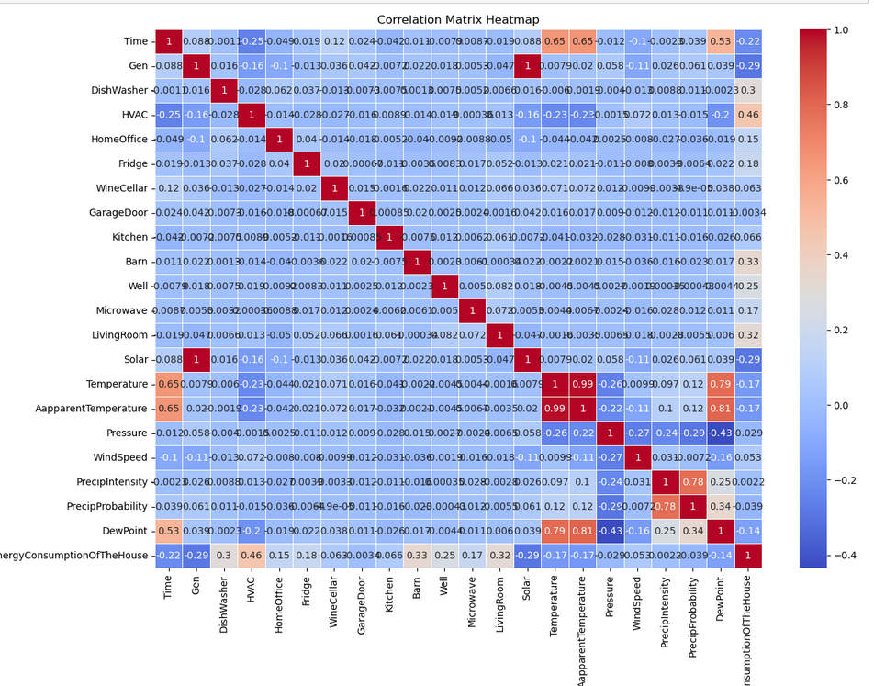
Data Screenshot

Slide 11
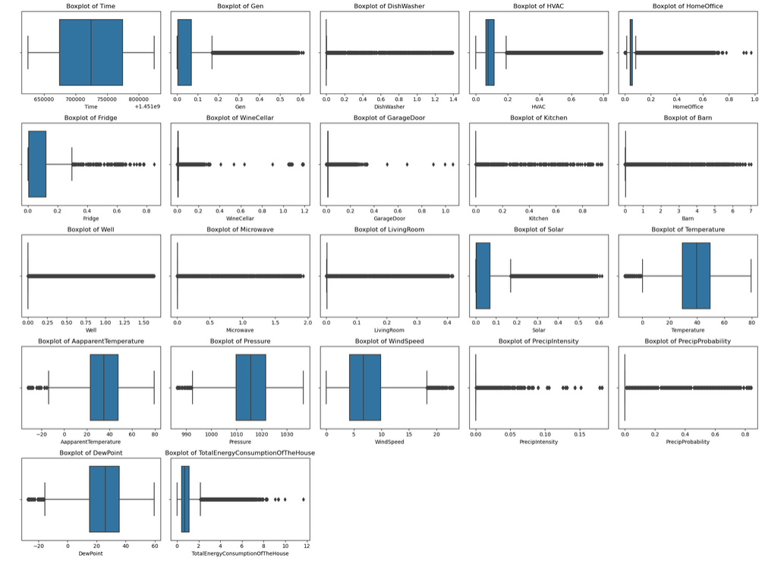
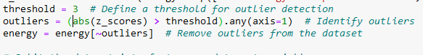
Outliers

Slide 12
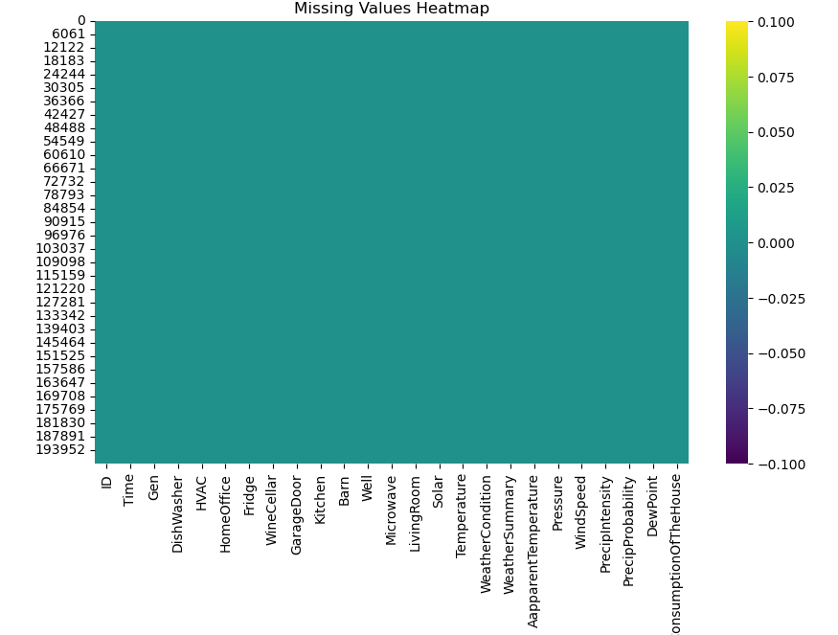
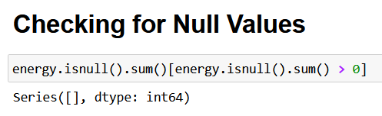
Data Cleaning
1. Finding the null values

Slide 13
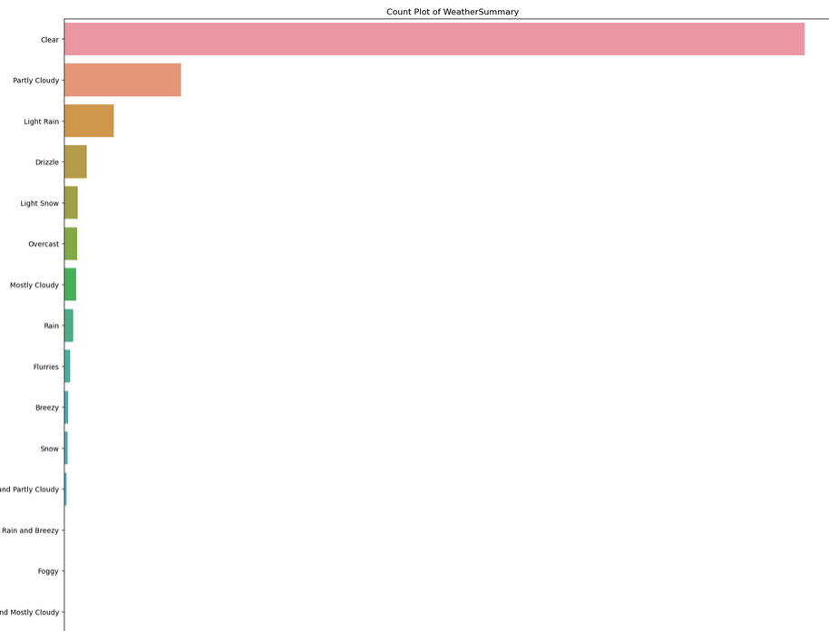
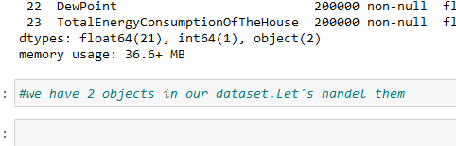
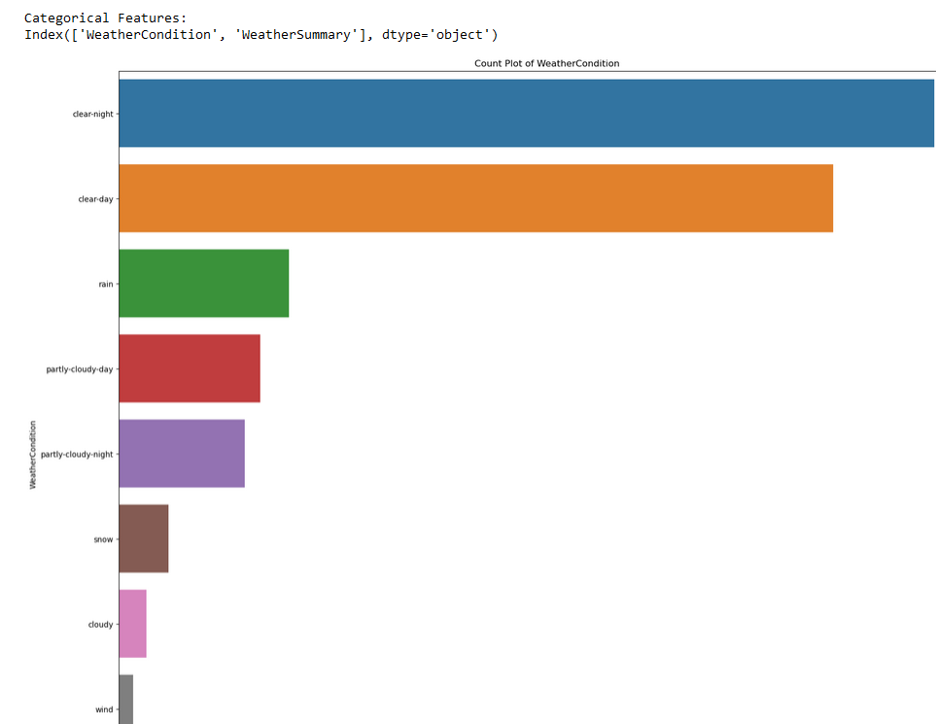
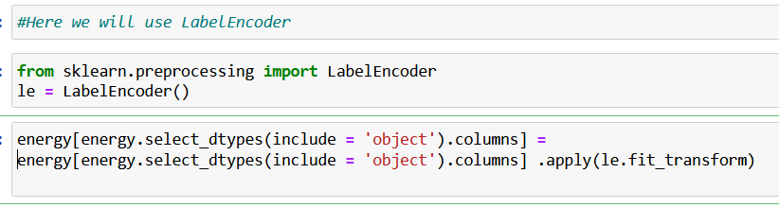
Data Cleaning
2. Replacing the object

Slide 14
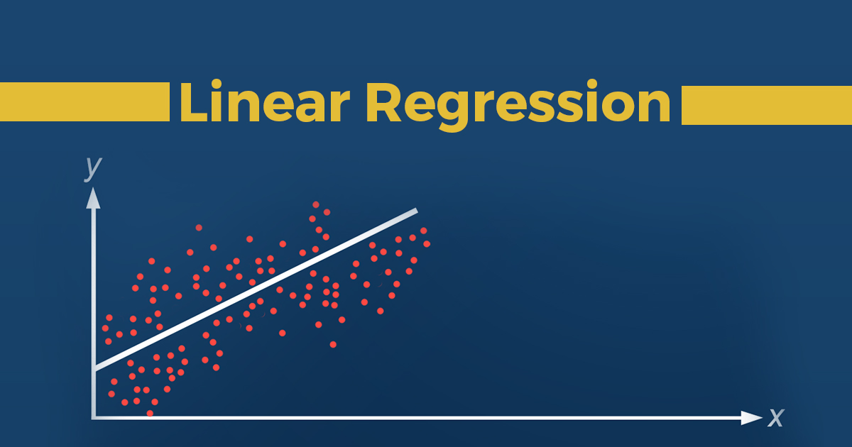
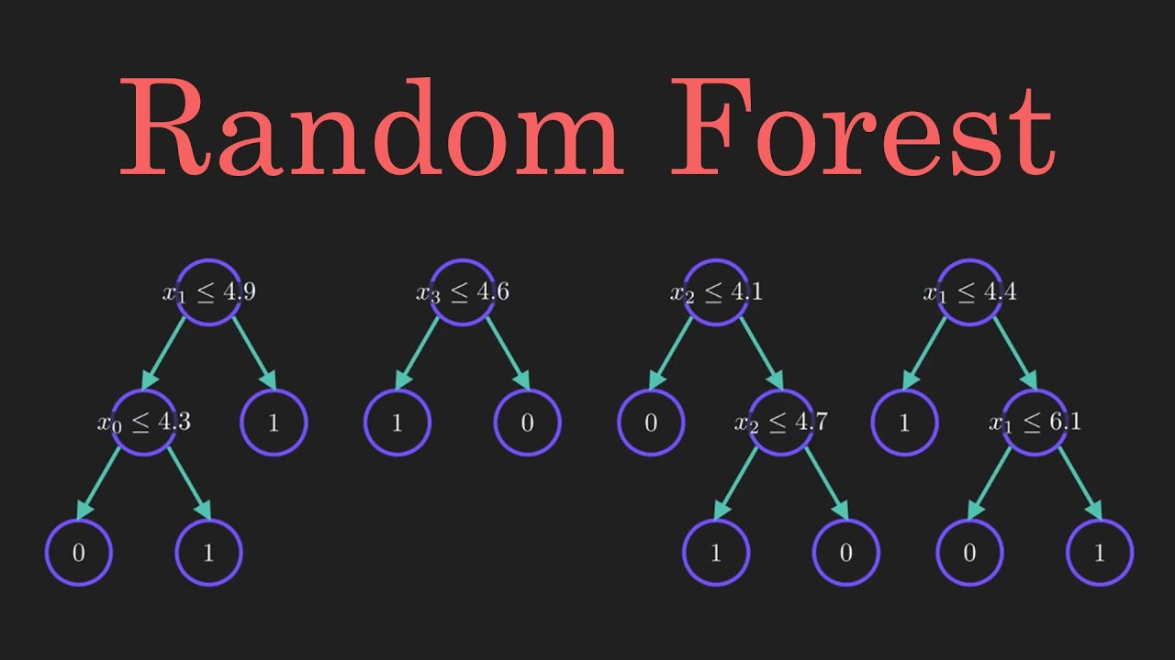

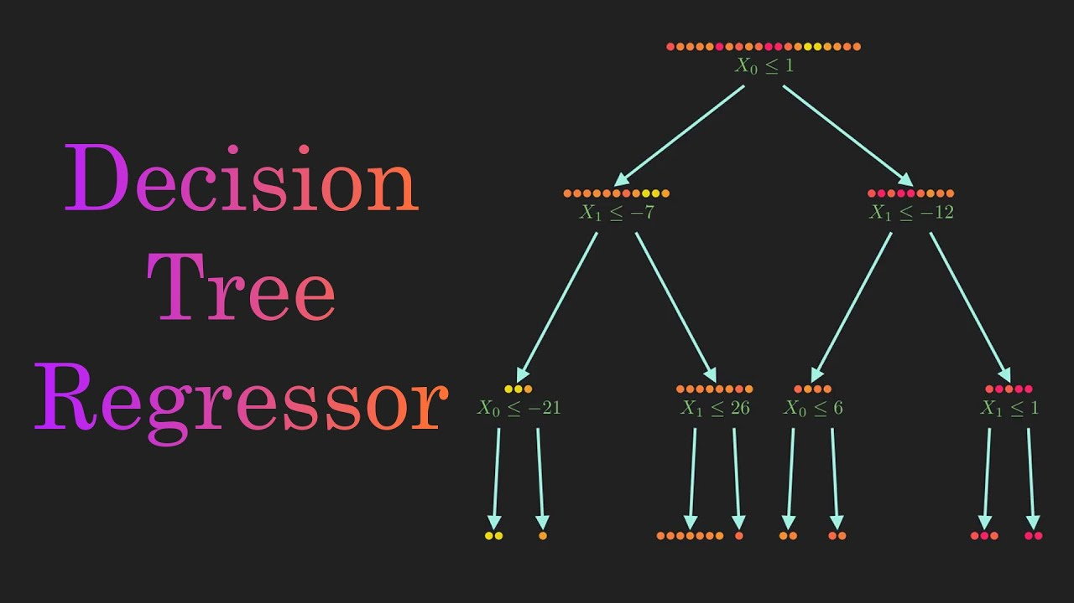

Models Used

Slide 15
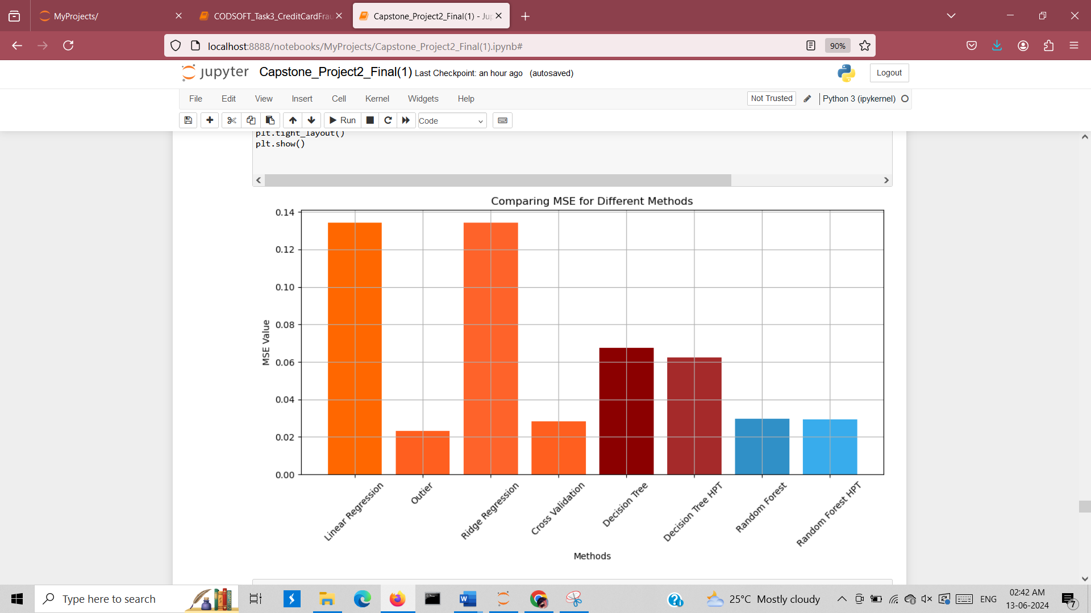
Result Screenshots

Slide 16
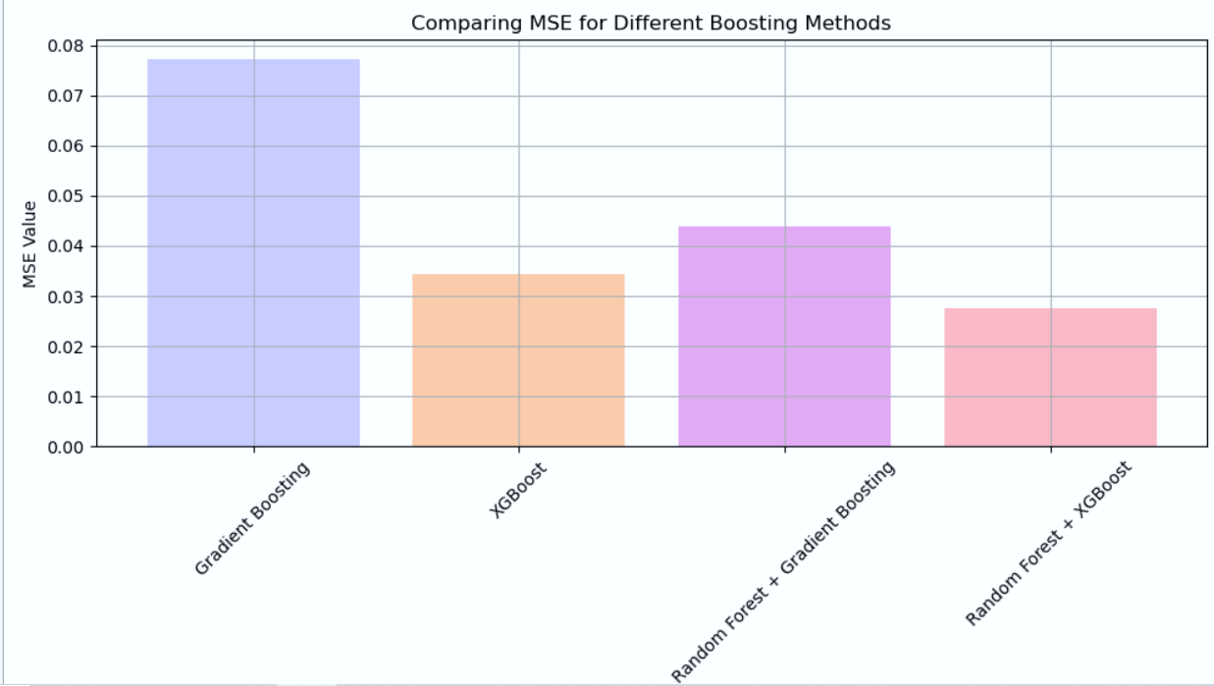
Result Screenshots

Slide 17
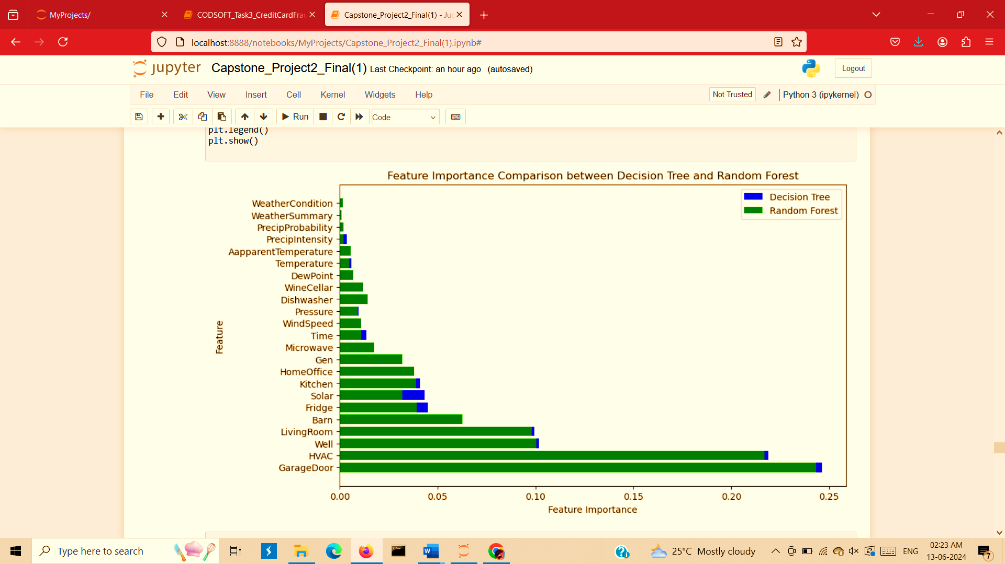
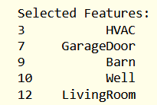
Result Screenshots
DT MSE = 2.840927879854139e-06
RF MSE = 0.011584535157549414

Slide 18
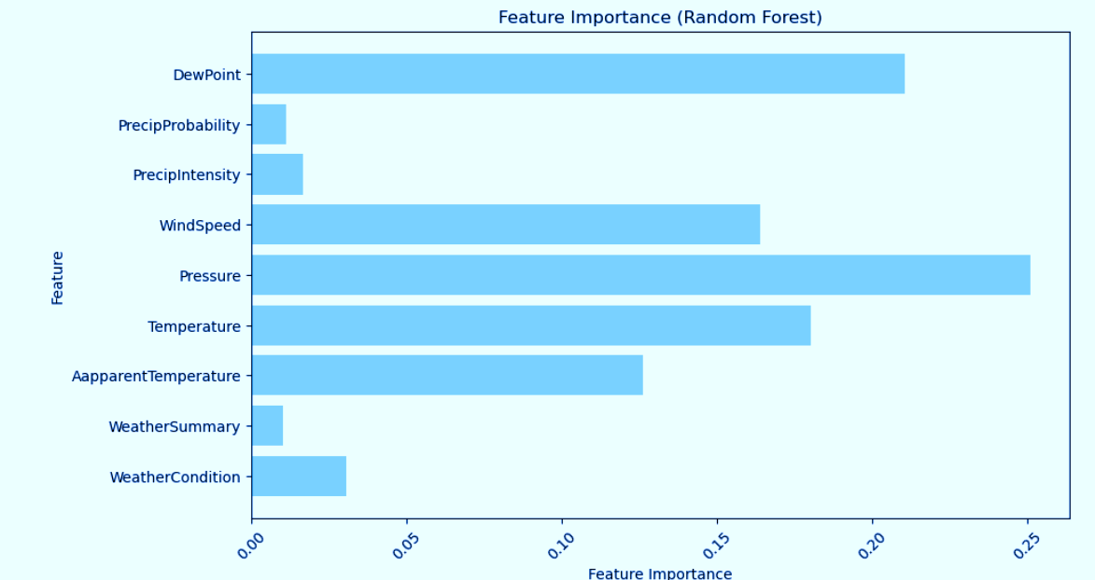
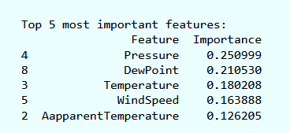
Result Screenshots (Environmental Conditions)

Slide 19

FUTURE SCOPE
Time Series Analysis
Deep Learning Techniques
Integration with IoT Devices

Slide 20
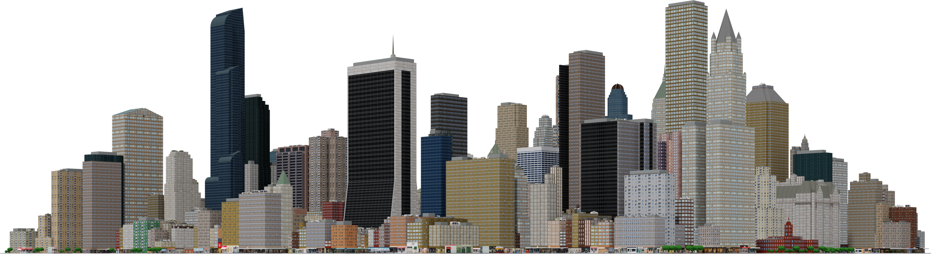
“Smart energy use is not just about saving money, it's about saving our future.”
Thank You!

